Slide 1
Arithmetic Ch 3
CS274
Prof. Ann Marie Schilling

Slide 2
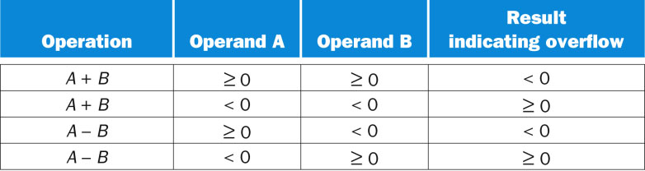
Overflow conditions

Slide 3
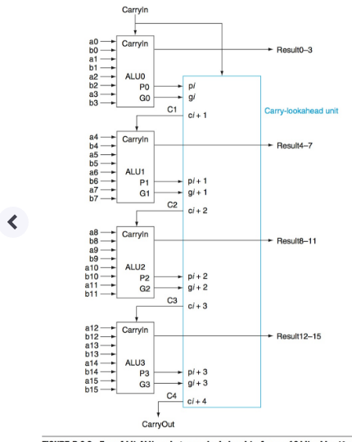
Carry Lookahead Hybrid

Slide 4
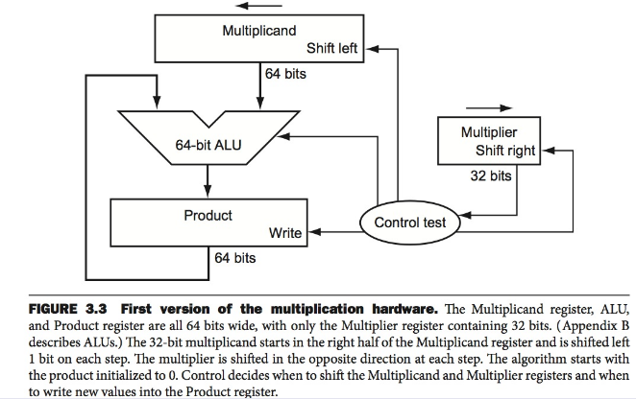
Multiply Hardware

Slide 5
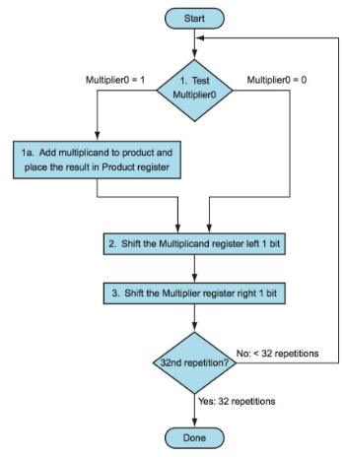
Multiply Flow

Slide 6
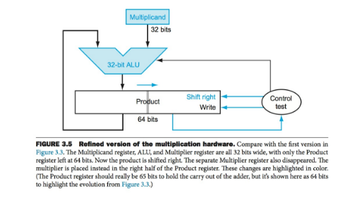
Refined Multiply

Slide 7
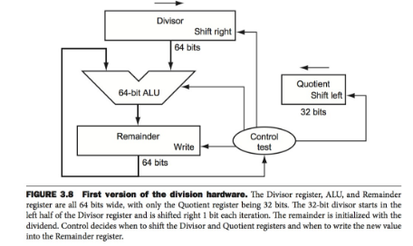
Divide

Slide 8
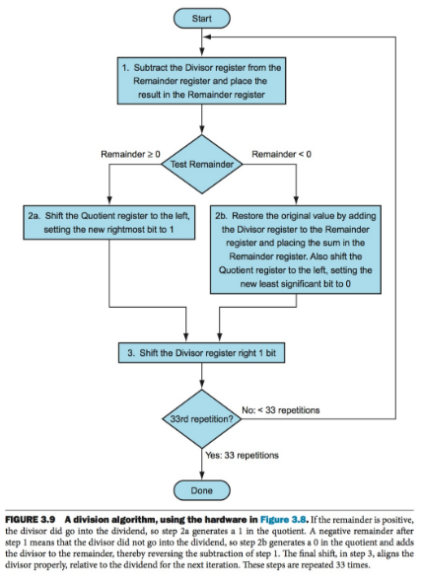
Division Flow

Slide 9
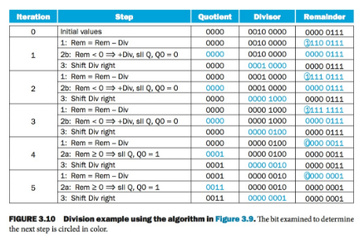
Division Trace

Slide 10
Mathematical Precision
The number of digits we use in our calculations indicate precision.
For instance:
3.14 has less precision than 3.1415

Slide 11
Precision
The farther we go past the decimal point, the more precision there is in our calculation.
Where do we round off?
Do we have to use as many values past the decimal point as possible?
Depends on your significant figure scheme.

Slide 12
Accuracy vs Precision
Accuracy: Number of digits past the decimal point
Precision: Total number of digits

Slide 13
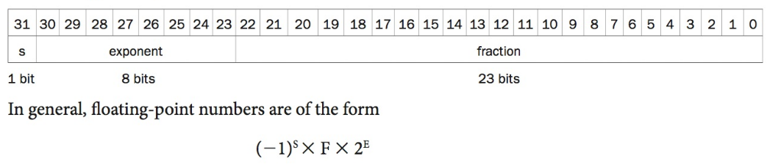
Floating Point – IEEE 754
MIPS representation

Slide 14
New Error!
Underflow
Fraction is so small that it can’t be represented in 8 bits…

Slide 15
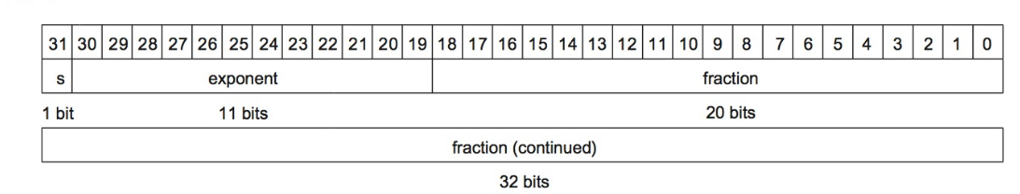
Solving Underflow – Double Precision

Slide 16
Why that order?
The order of the fields: Sign, Exponent, Fraction
Why do you think they are in that order?
Comparison! First we compare sign, then the exponent then the fraction.

Slide 17
Getting more out of our space: Normalizing
Value Normalized Exponent
1101.101 1.101101 3
.00101 1.01 -3
1.00001 1.00001 0
1000001.11 1.00000111 6
What is in common between the normalized values?
How can we use this to be more efficient?
What is a restriction?

Slide 18
Terms:
1.01111 * 2²
mantilla
exponent
Assumed

Slide 19
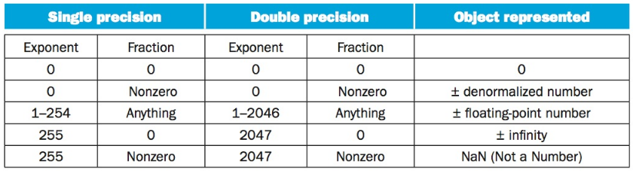
Representing Special Values
An assumed 1 means we have to have a special representation for 0.

Slide 20
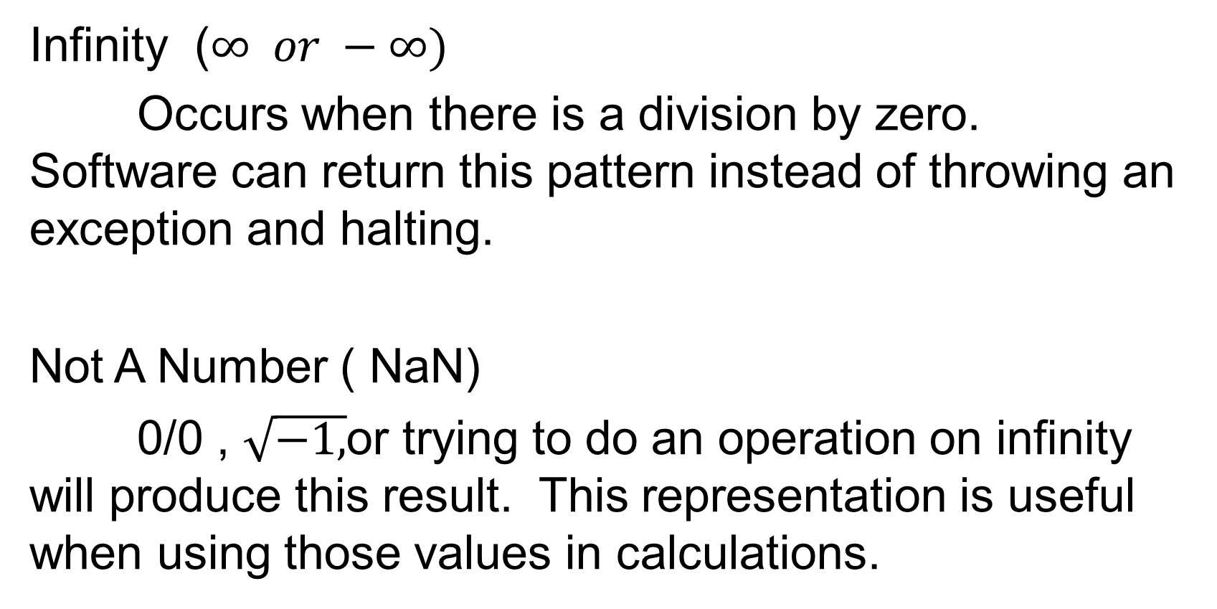
Special Values
Infinity ($∞ or −∞)$
Occurs when there is a division by zero. Software can return this pattern instead of throwing an exception and halting.
Not A Number ( NaN)
0/0 , $\sqrt{−1,}$or trying to do an operation on infinity will produce this result. This representation is useful when using those values in calculations.

Slide 21
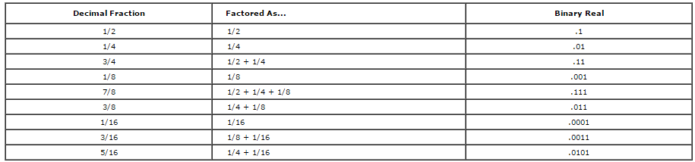
A useful table:
http://kipirvine.com/asm/workbook/floating_tut.htm

Slide 22
Biased Notation
We said that we store the exponent ahead of the fractional part for comparison reasons…..

Slide 23


Negative Exponents and Comparisons
Why are the fields in the Floating Point format in the order sign, exponent, fraction?
So… say, we have two positive single precision floats with the following exponents:
Which is larger? Left or Right?

Slide 24
Comparing Exponents in FP
The one on the right!
We represent the values in two’s complement:
-1 1

Slide 25
Comparing Exponents in FP
To make comparison easier, exponents are stored in biased notation .
Biased notation adds a value to the exponent so that the most negative exponent is represented as all 0’s and the most positive as all 1’s
Consider this a “shift” of the values

Slide 26
Biased Exponent Example
IEEE 754 uses 127 bias for single precision and 1023 for double
-1 exponent is represented by bit pattern for -1+ bias
So that would be the bit pattern for 126₁₀ which would be 01111110₂

Slide 27
Converting from Decimal to Binary FP

Slide 28
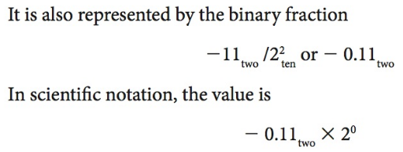
Converting – First, Powers of 2

Slide 29
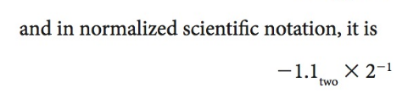
Converting: Normalizing

Slide 30
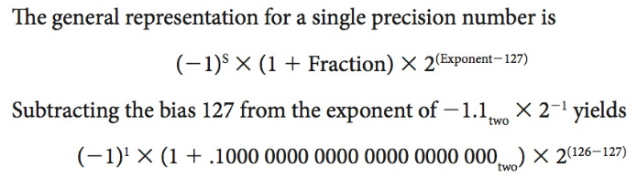
Converting: Adding the bias

Slide 31
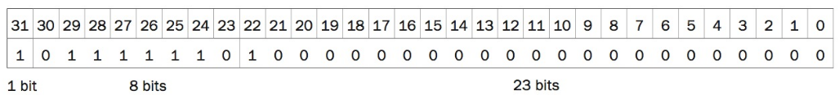
Finally:

Slide 32
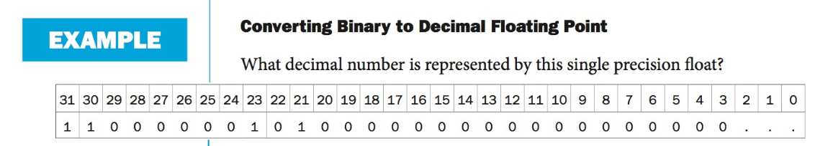
Your Turn!

Slide 33
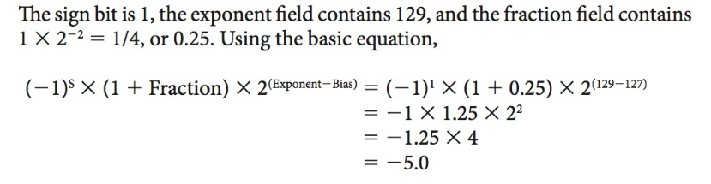
Solution

